Slide 1

Experiential Learning Programme (ELP)
Organic Farming
Presentation
School of Agriculture, Graphic Era Hill University, Dehradun248001, Uttarakhand, India
Submitted By
CHOUTAPALLI NAVEEN
I’d no.- 19471255
Batch 2019-2023

Slide 2
Content:-
1-Introduction Of Experimental Learning Programme.
2- Objectives Of ELP .
3- Introduction Of Food Processing
4- Objective of food processing
5- Techniques of preservation
6- Methods of food preservation
7- Processing:- Jam
Orange squash
Amla pickle
Pine Apple jam
8- Conclusion.

Slide 3
Experiential Learning Programme [ELP]
Experiential learning programme (ELP) has been introduced at Bachelor degree with the specific objective of learning by hands-on participation, by trying, making errors, and gradually narrowing the margin between failure and success. Work-based experiential learning through agricultural-related supervised experiences provides practical, real- world experiences in agriculture, develop a positive work ethic, and meet realistic occupational expectations.
Experiential learning modules namely plant tissue culture, mass production of bio- agents and bio-pesticides, hi-tech horticulture, fruits & vegetable processing, visual & graphic communication, Agri Business Management and Crop Production (organic farming).

Slide 4
Objective Of Experiential Learning Programme
To promote professional skills and knowledge through hands on experience.
To build confidence and ability to work in project mode.
To acquire enterprise management capabilities.

Slide 5
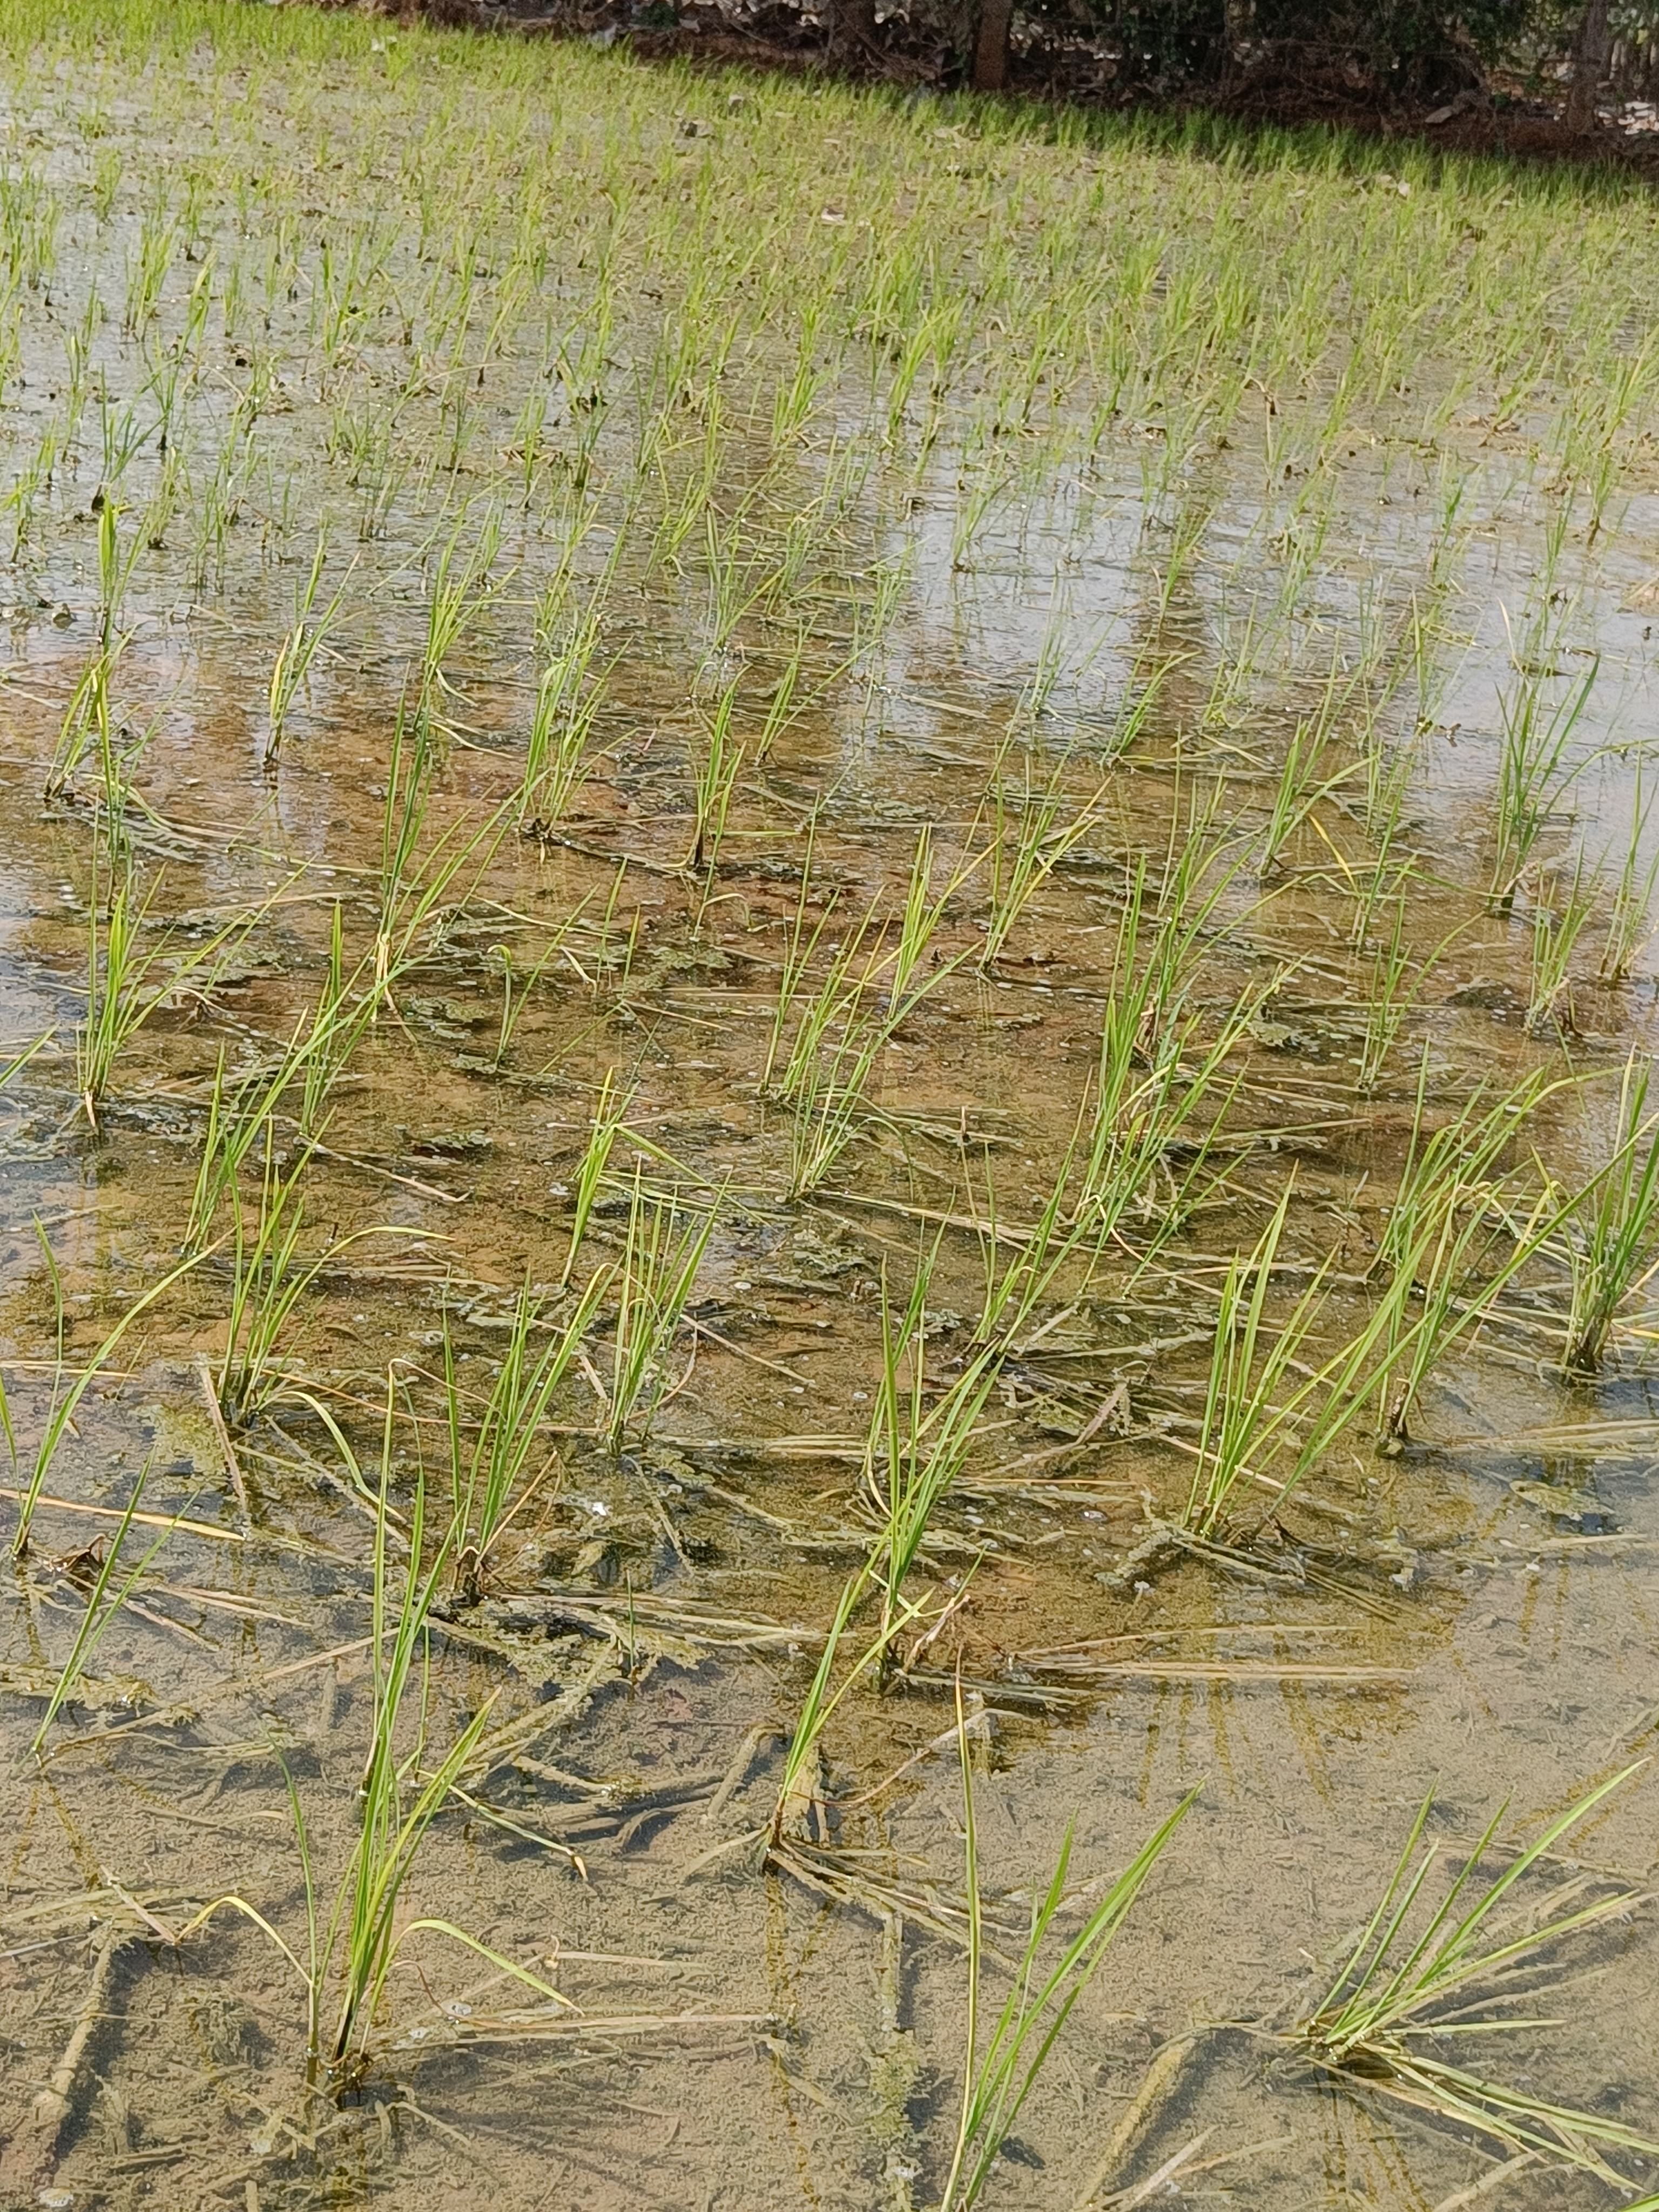
What is mean by organic farming ?
Organic farming is a method of crop and livestock production that involves much more than choosing not to use pesticides, fertilizers, genetically modified organisms, antibiotics and growth hormones.

Slide 6
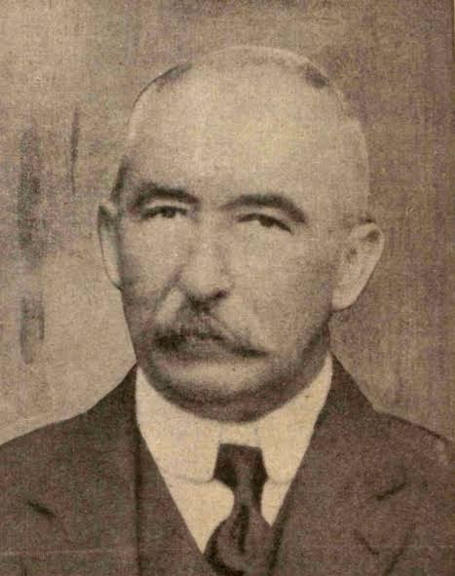
Organic farming in India
Organic cultivation not new in India
The term organic farming was first used by lord northbourne in the book of look of the land
➤ Organic agriculture in India started long back 1900 by Sir Albert Howard a British agronomist, in local village of the north India.
➤ Organic farming first coined by north Bourne in 1946.
The state of Sikkim and Uttaranchal declared organic state.
➤ Race less use of this chemical material not alert the ecosystem but it claim with death to many lives every year due to their hazardous nature.
Albert Howard

Slide 7
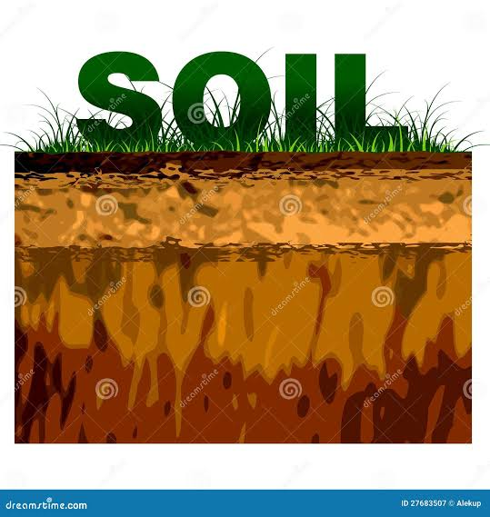
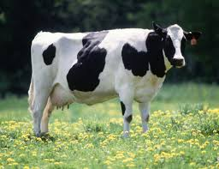
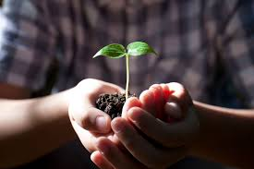
WHY ORGANIC FARMING?
Health food: Contains no toxic substance.
Natural and good taste.
Higher benefit cost ratio due to less
External input use and premium price(20-25%).
Takes care of environmental concerns of farming.
Animal
Plant

Slide 8
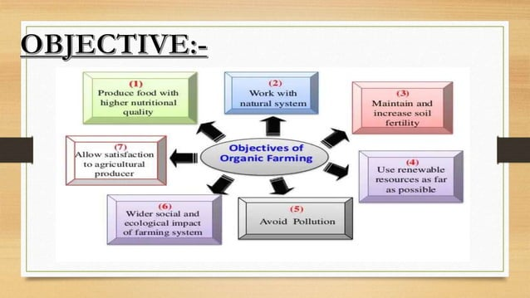
Objectives Of Organic Farming

Slide 9
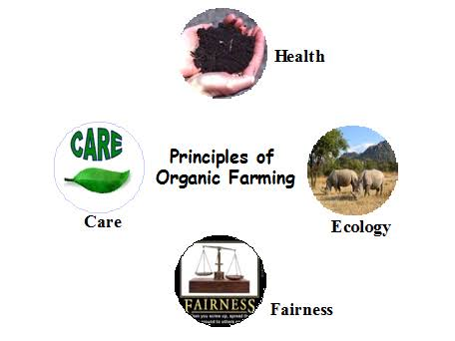
Principles of organic farming
Four principles of organic farming .
Principle of health.
Principle of ecology.
Principle of fairness.
Principle of care .

Slide 10
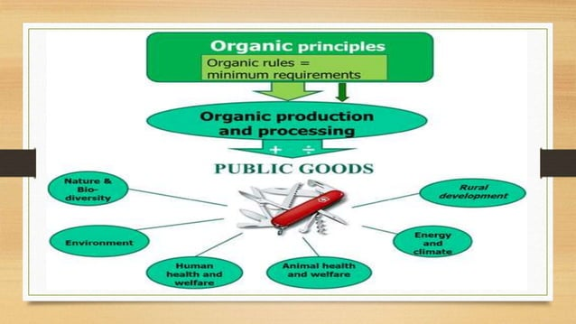

Slide 11
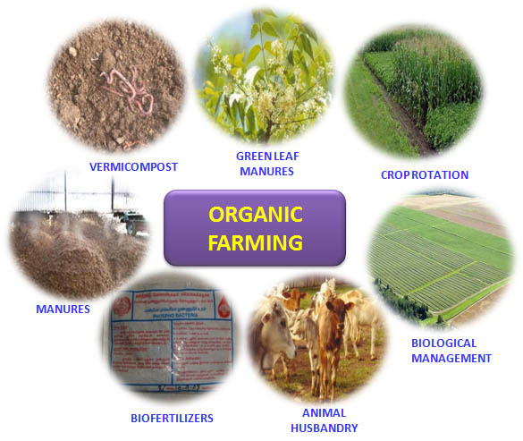
Components of Organic Farming

Slide 12
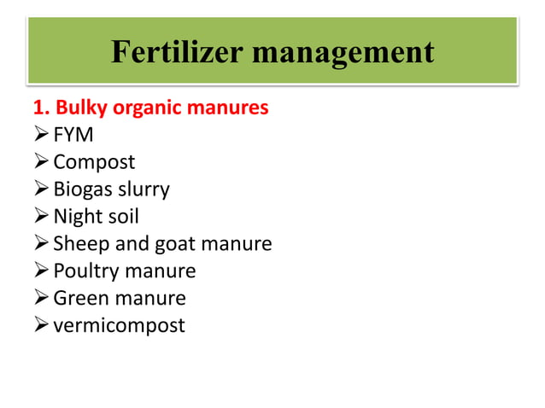

Slide 13
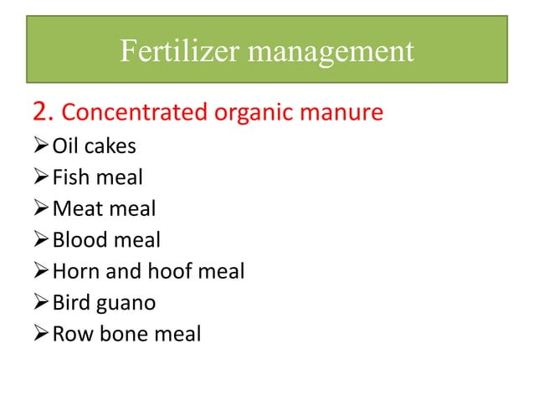

Slide 14
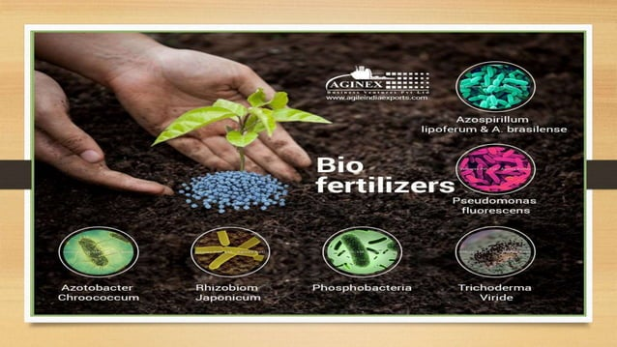

Slide 15
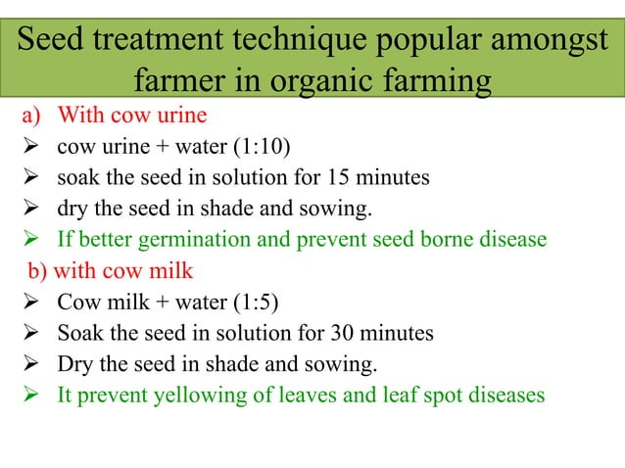

Slide 16
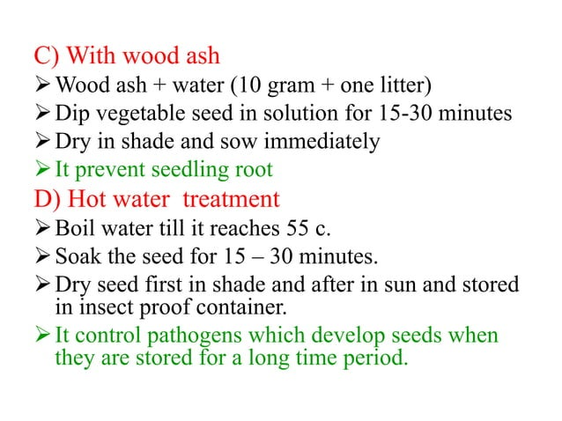

Slide 17
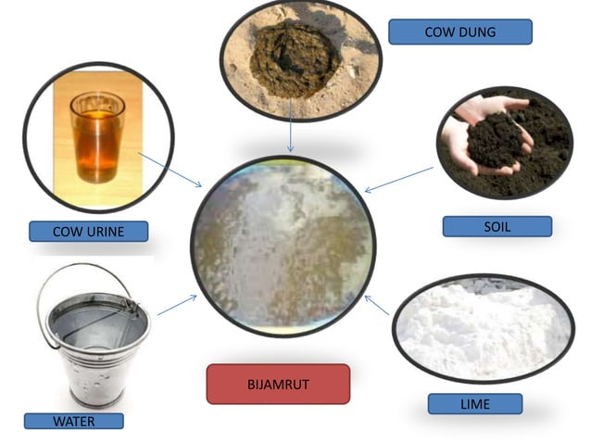
Preparation of Bijamrut
Ingredients:-
Cow dung:-2.5 kg
Cow urine:- 2.5 litre
Soil:- 25 gm
Lime :- 25 gm
Water :- 10 litre

Slide 18
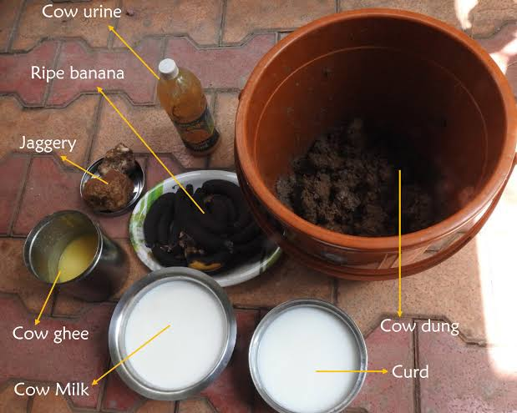
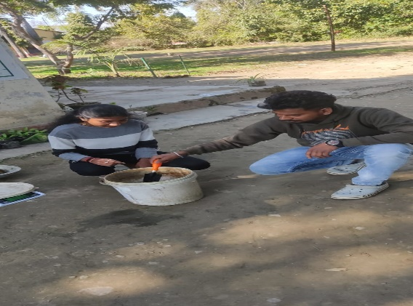
Preparation of Panchagavya
Ingredients:-
Cow dung – 3.5 kg
Cow ghee – 500g
Cow milk – 1.5 liters
Cow curd – 1 liters
Cow Urine – 5 liters
Water. – 5 liters
Additional:-
Jaggery – ½ kg
Ripened banana – 6 number
Mixing all ingredients with measurements

Slide 19
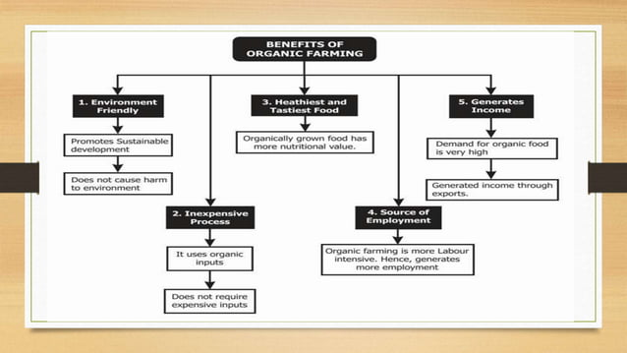

Slide 20
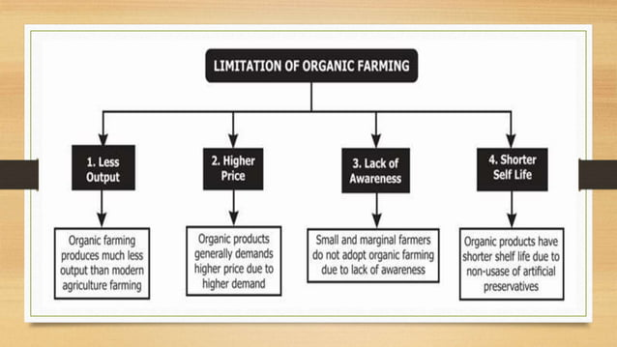

Slide 21

Conclusion
Organic Farming environmentally friendlly.
No harm to nature.
Good for health.
If we follow this Organic Farming it will provide healthy generations.
Don't waste food.
Save food & save farmers.

